Slide 1
Behind The Computer Science
Presented by
Thura Lin Htut
Nyan Min Htet
Nay Lin Htun
Nyan Lin Bo
Kaung Sithu Hein

Slide 2

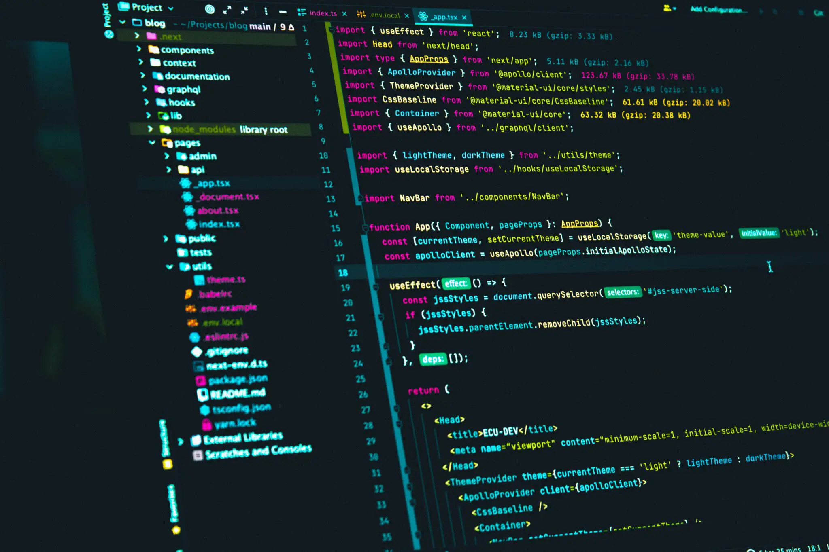
Most people think that Programming is a confusing and mental break down job. Yes, they are right in some situations, but not at all.

Slide 3

Computer science, the study of computers and computing, including their theoretical and algorithmic foundations, hardware and software, and their uses for processing information. The discipline of computer science includes the study of algorithms and data structures, computer and network design, modeling data and information processes, and artificial intelligence. Computer science draws some of its foundations from mathematics and engineering and therefore incorporates techniques from areas such as queueing theory, probability and statistics, and electronic circuit design. Computer science also makes heavy use of hypothesis testing and experimentation during the conceptualization, design, measurement, and refinement of new algorithms, information structures, and computer architectures.

Slide 4
Computer Science
Computer Engineering
Computer Science
Information Systems
Information Technology
Software Engineering
Computer Science is considered as part of a family of five separate yet interrelated disciplines: computer engineering, computer science, information systems, information technology, and software engineering. These five disciplines are interrelated in the sense that computing is their object of study, but they are separate since each has its own research perspective and curricular focus.

Slide 5
Computer Science
Computer Architecture
Programming Languages
Software Development
The major subfields of computer science include the traditional study of computer architecture, programming languages, and software development.

